Slide 1

Phoenix College
ASCEND

Slide 2
Our Team
Mechanical
Tory Galat
Benito Rincon
Power Distribution
Jacqueline Do
Samuel Jimenez
Atmospheric Profiling
Richard Ricketts
Video Streaming
Maxx Mudd
Drew Corona
Video Stabilization
Karla Chao
Sandra Montero
Faculty Mentor: Ernest Villicana Team Lead: Meghann Boland

Slide 3
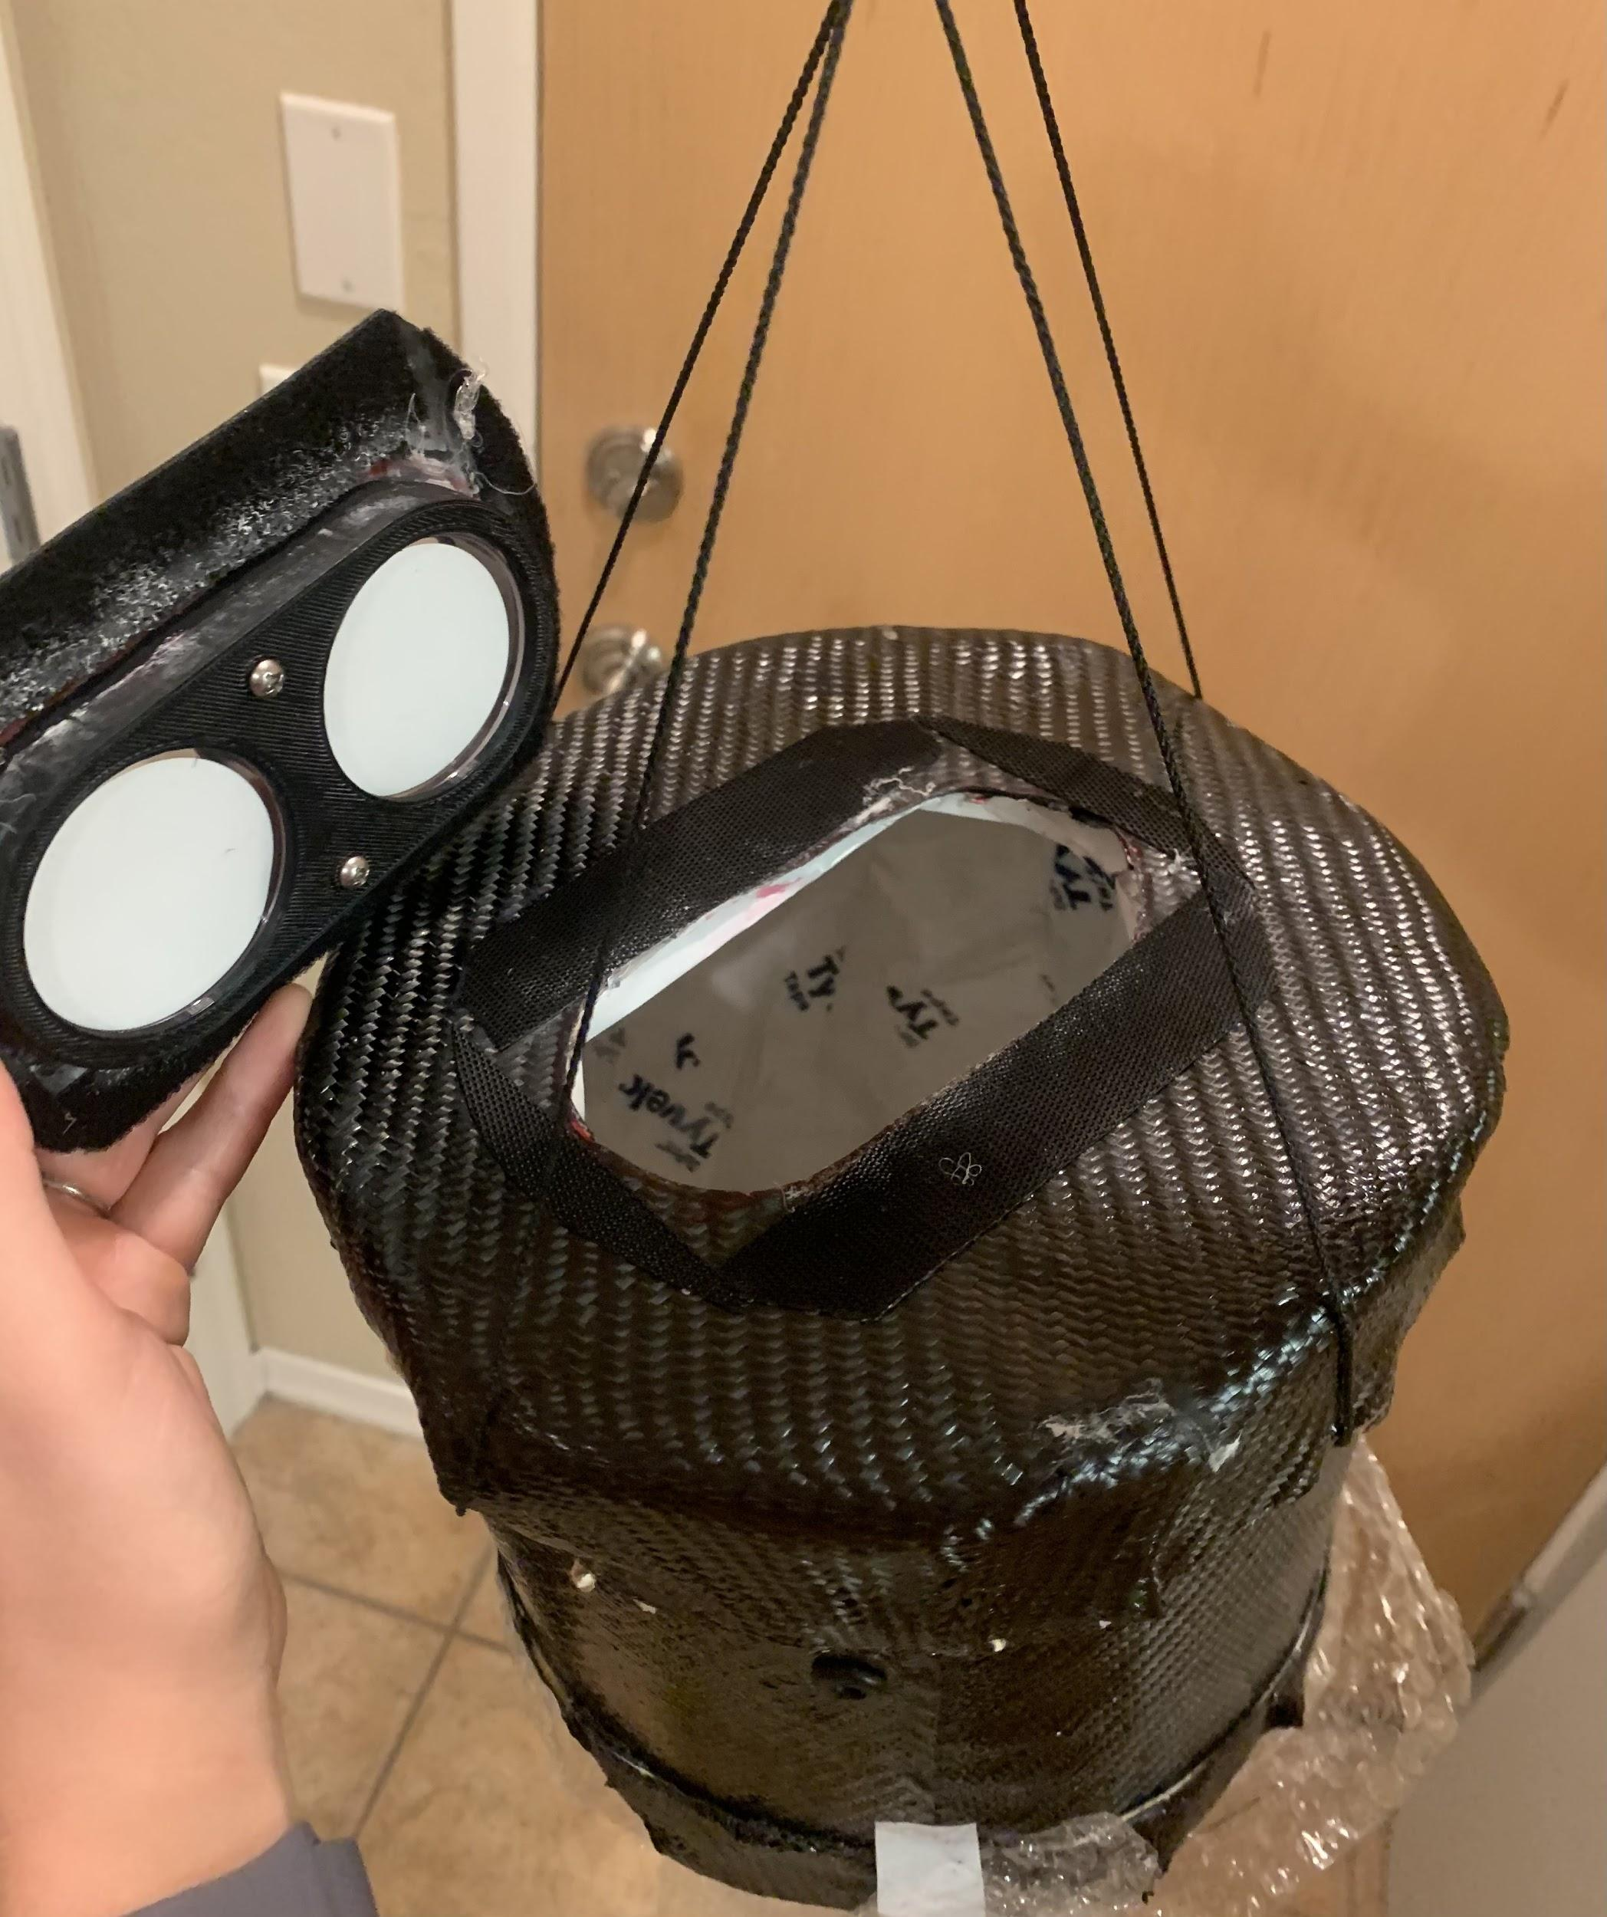
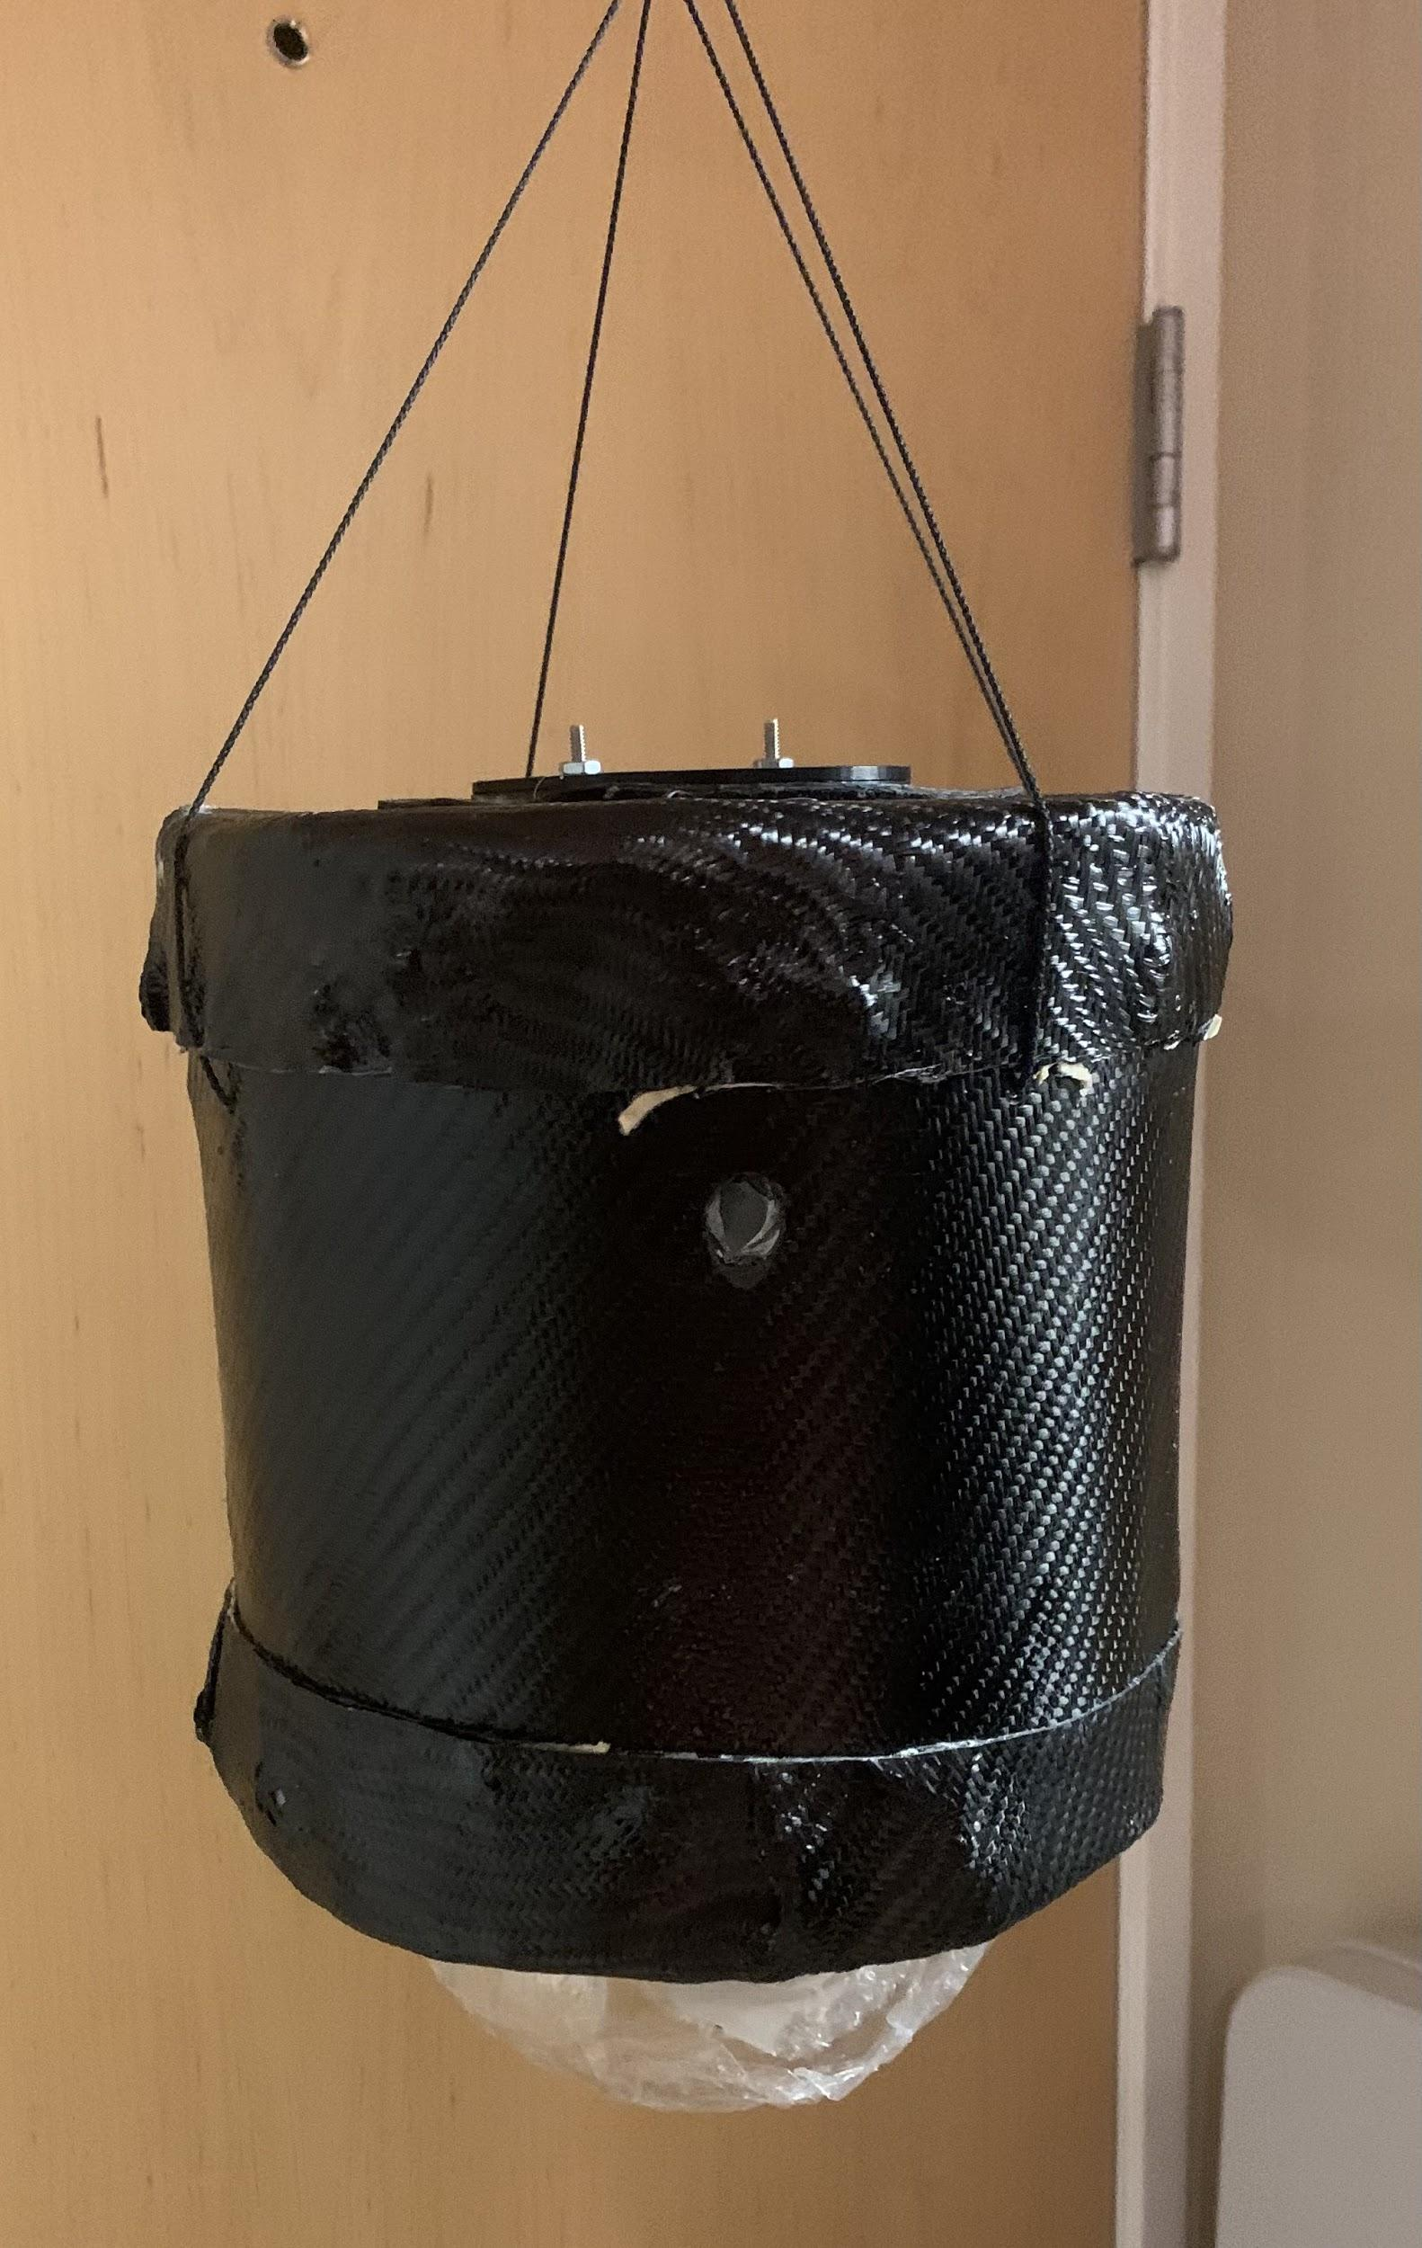
Mechanical
Cylindrical carbon fiber housing
6in. Acrylic dome
A space blanket and wax paper used as insulation
Biological experiment that is easily removable
Internal structure was 3D printed
Designed in a rectangular shape
Internal structure can easily be inserted or completely removed
Velcro and screws were used to attach the components to the internal

Slide 4
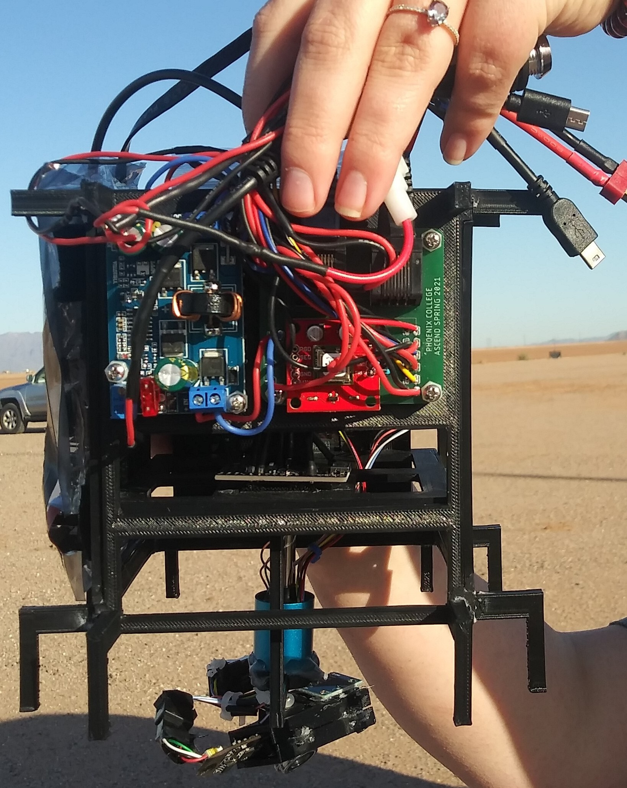
Mechanical - What Went Well
Carbon fiber housing was a success and kept everything inside
Pegs on internal helped with stabilizing
The velcro kept everything in place
Screws were able to keep both caps on the housing
No components were damaged
Dome was a success staying attached
Space blanket & wax paper stayed wrapped on walls

Slide 5
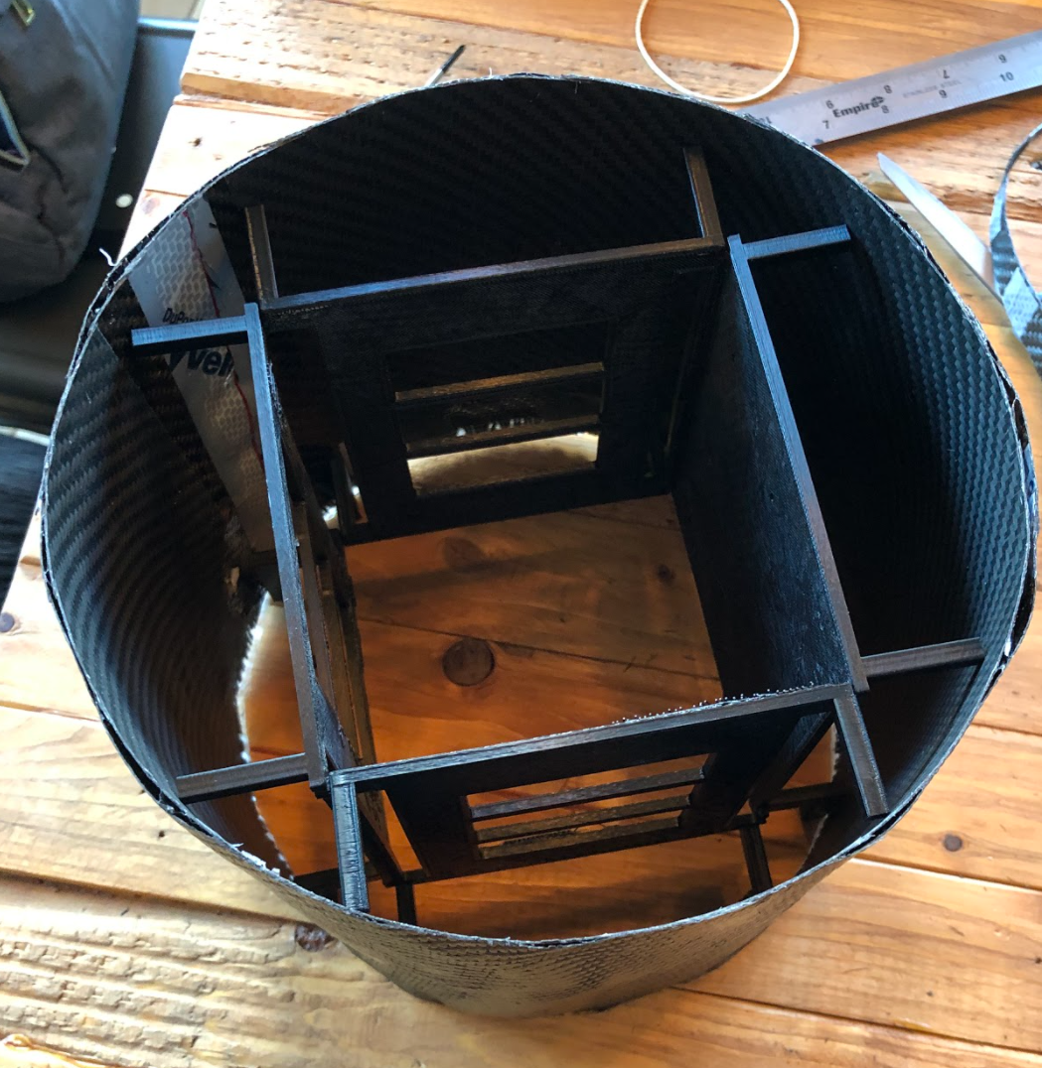
Mechanical - What Could Have Been Improved
Reducing the dimensions of the internal and external structure
Increasing the strength of the side supports on the internal structure
Taking off the bottom supports on the internal structure
Screwing the dome directly to the external structure

Slide 6
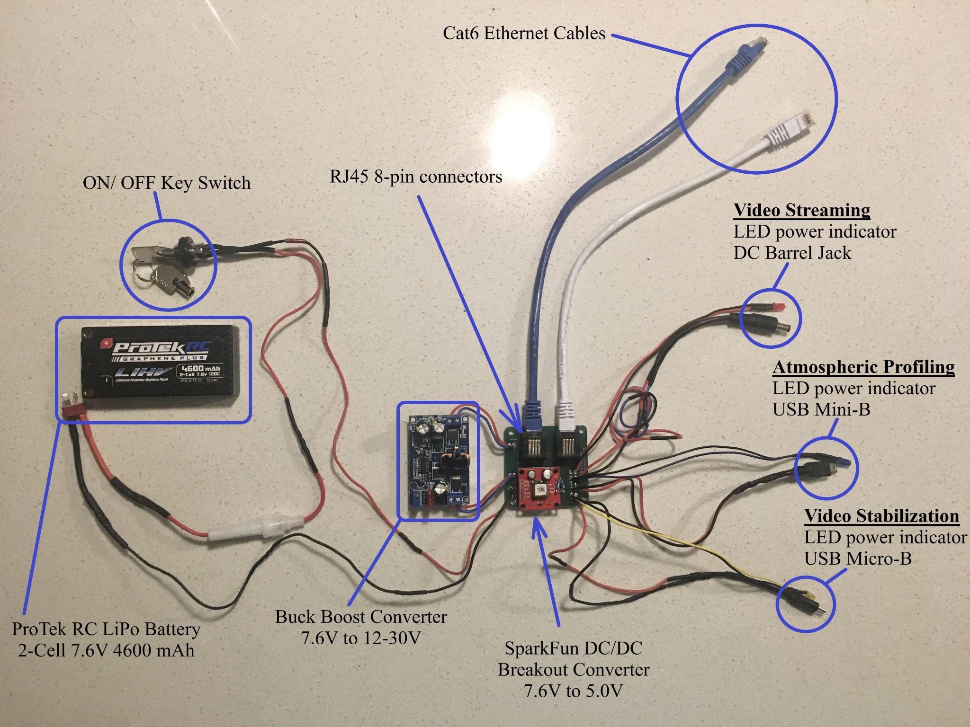
Power Distribution
Custom designed compact Printed Circuit Board (PCB) on Autodesk Eagle
  PCB sponsored and manufactured by Advanced Circuits.
5V and 12V power lines accomplished with Step Up and Step Down converters.
Lightweight 165g LiPo Battery
On/Off Key switch
LED power indicators for each sub system.
Two RJ45 headers
Custom DC Barrel Jack, Mini-B, and Micro-B USB cables.

Slide 7
Power Distribution
Outcomes and Future Endeavors
Total usage: 2997 mAh out of 4600 mAh
Components including the battery were intact.
  No indications of puffiness, swelling, or overheating were present.
PCB’s dimensions: 54.61 mm by 56.89 mm
  Compact design minimizes weight and space.
Battery size is smaller in comparison to previous semesters’ launches.
  Reduction in weight and capacity.
More research and testing:
  New battery technology
  Supercapacitors
  OLED power monitor module as opposed to LED power indicators.
  GUI in video stream that will display battery percentage and other useful information.
  Weight reduction in battery and buck boost converters.

Slide 8
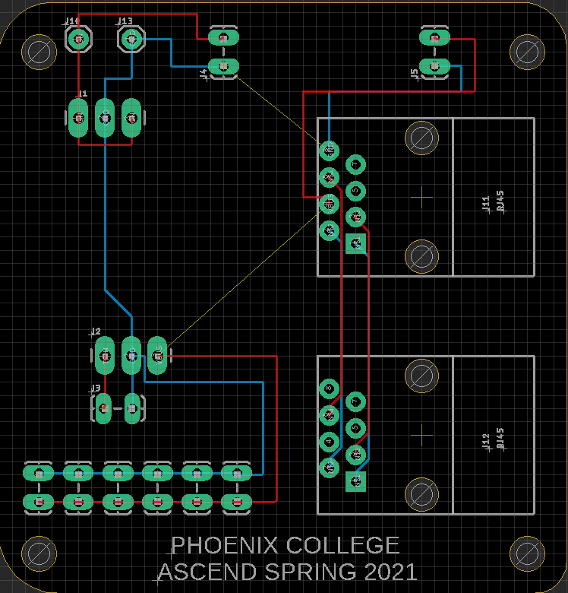
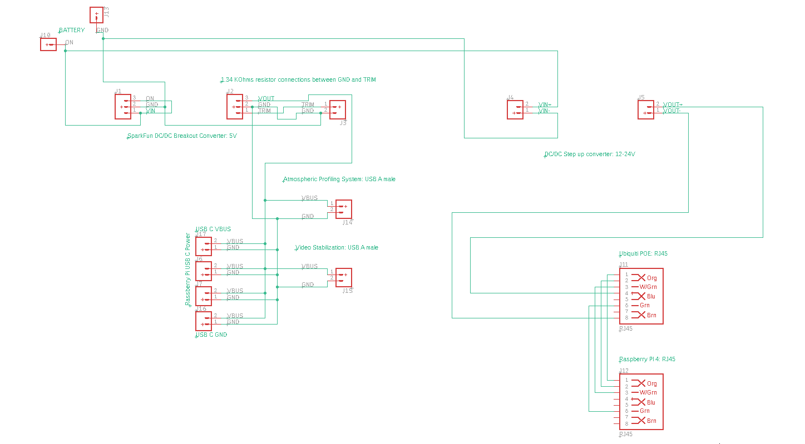
Power Distribution
Schematic and Printed Circuit Board

Slide 9
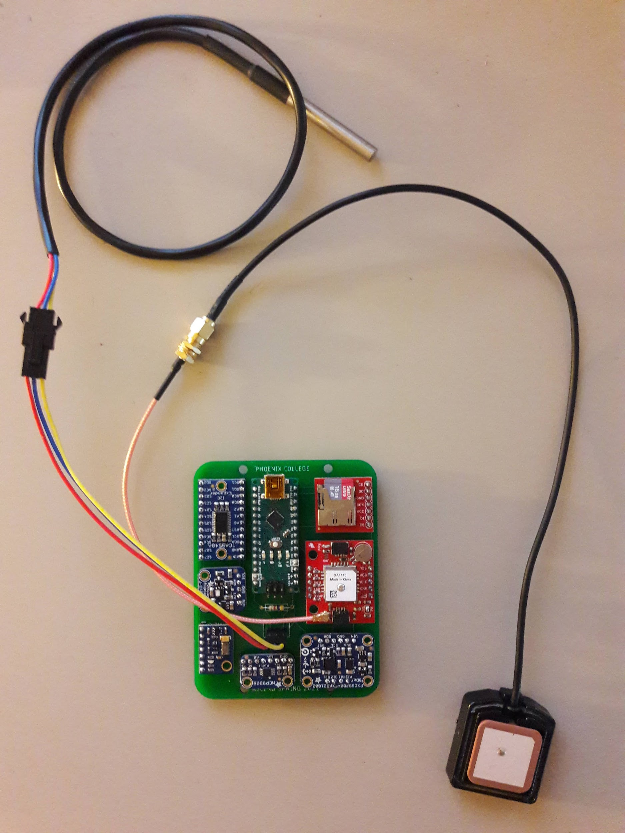
Atmospheric Profiling
Designed an atmospheric instrument that measures vertical profiles of ambient temperature, pressure, humidity, GPS data, and spatial orientation.
The data from the recordings will be recorded to a SD card that will be processed upon retrieval of the payload.
These recorded measurements will be used to create detailed data visualizations, as well as virtually replicate the flight.
This interation’s improvements were focused around designing a PCB to reduce weight and limit shorting/connection issues.

Slide 10
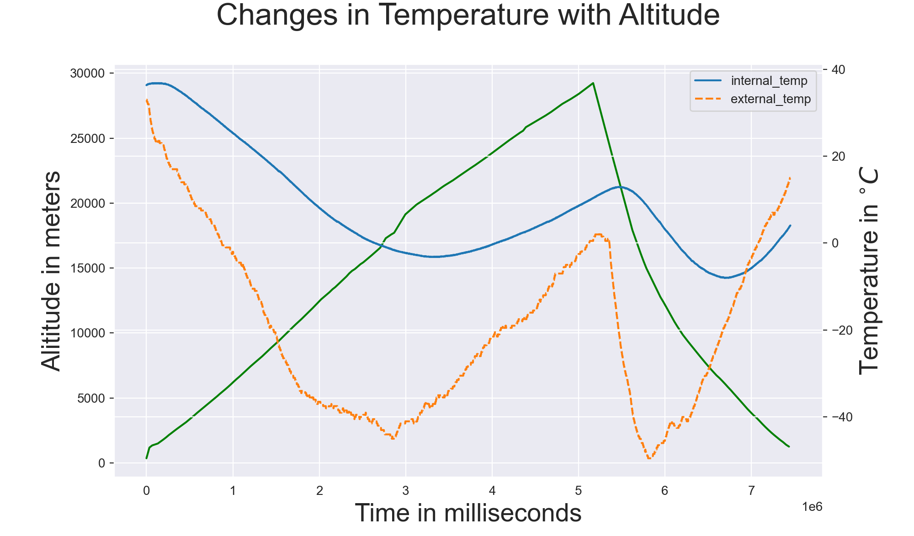
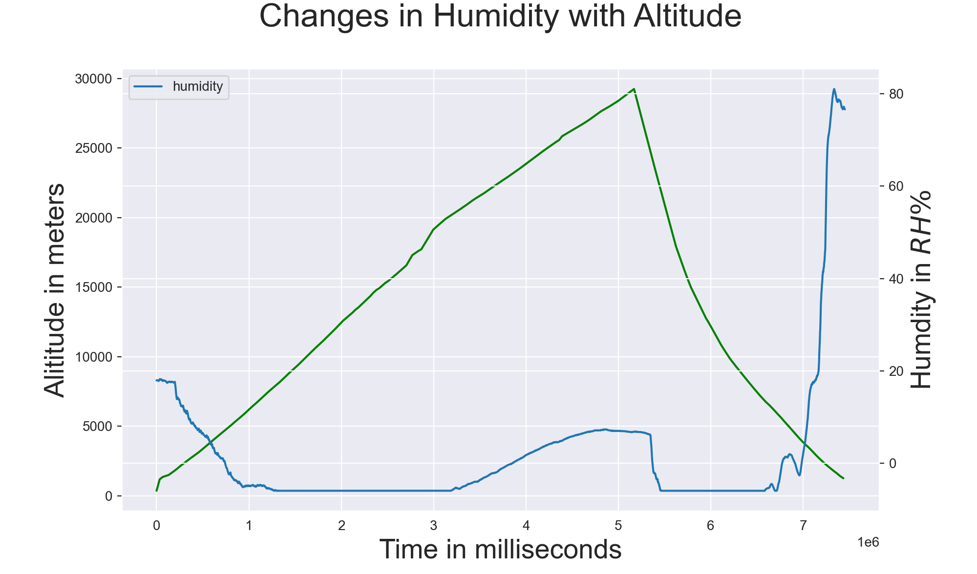
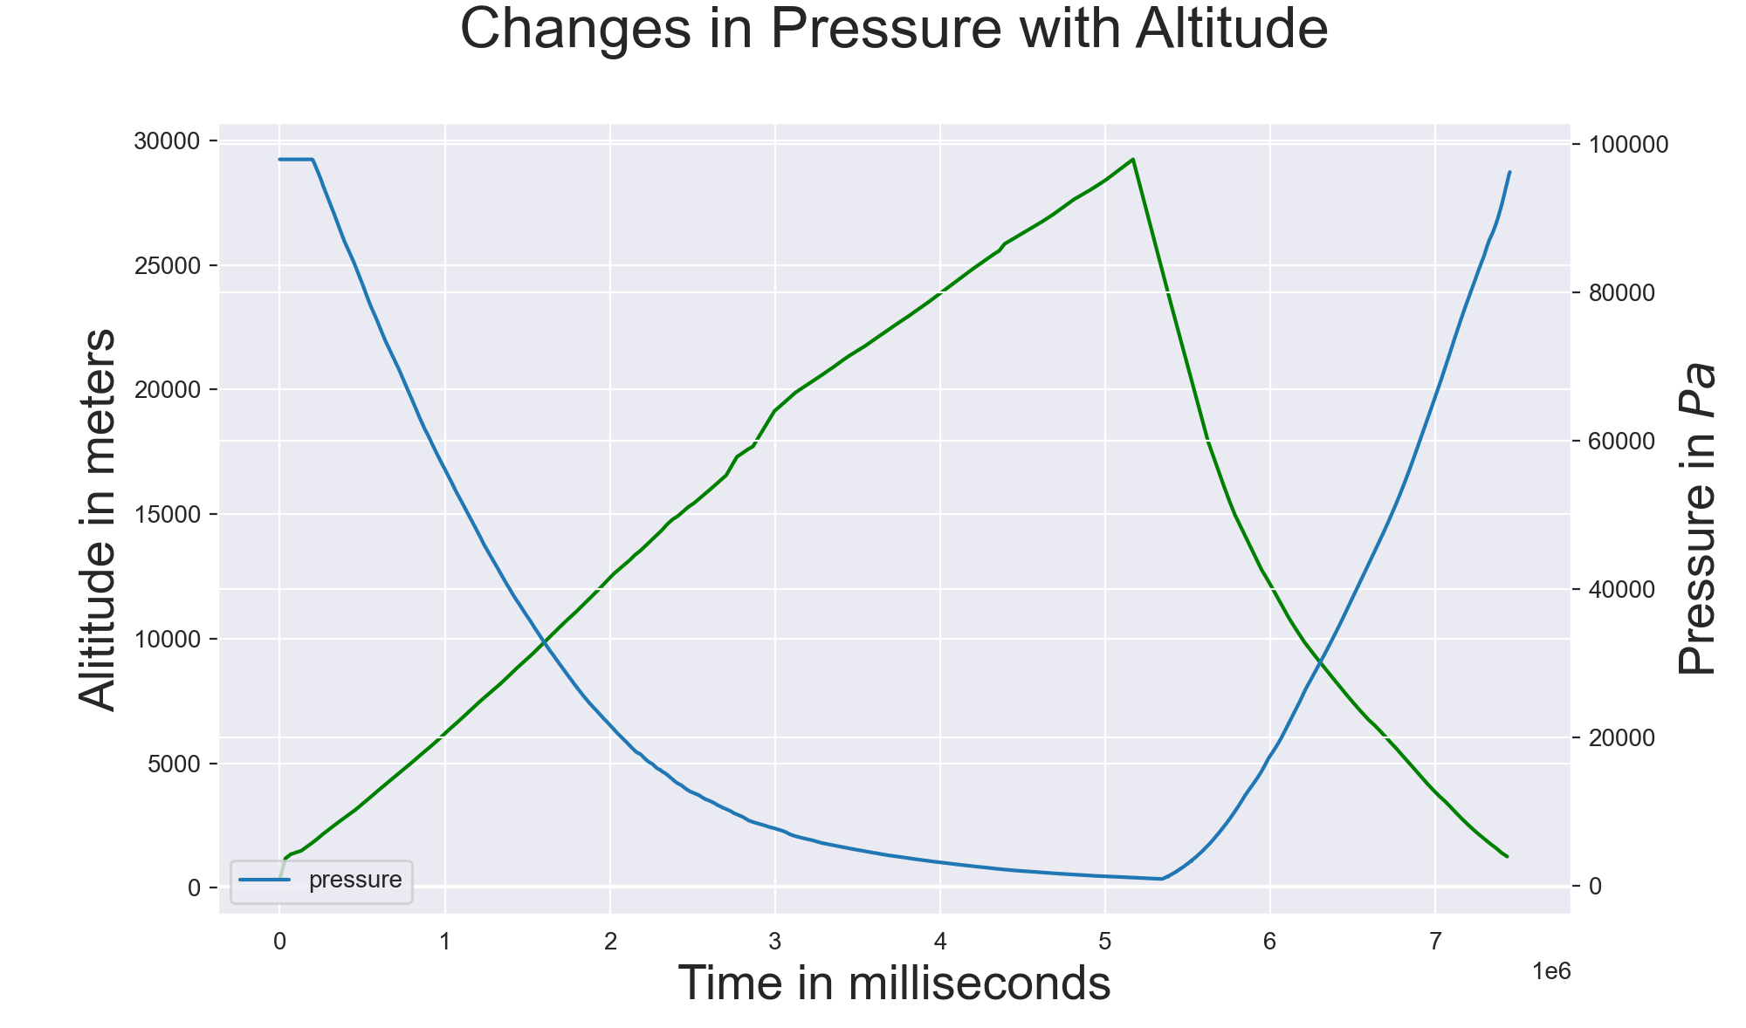
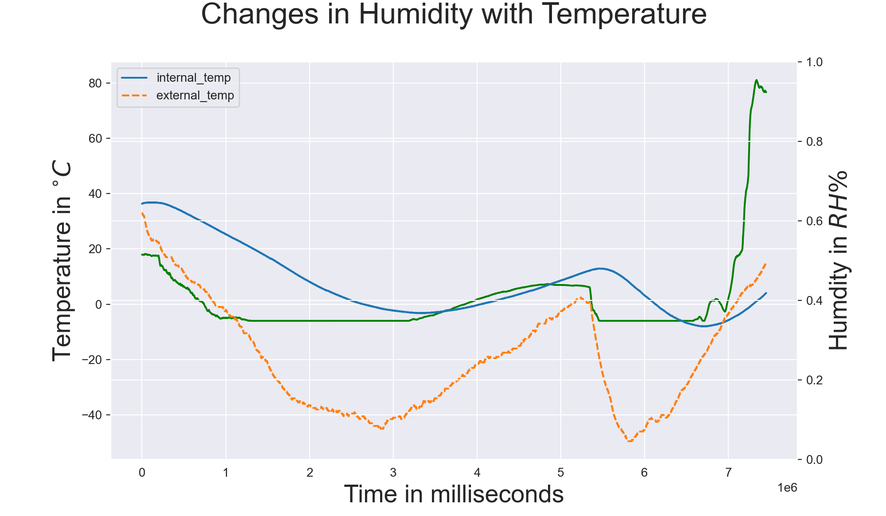
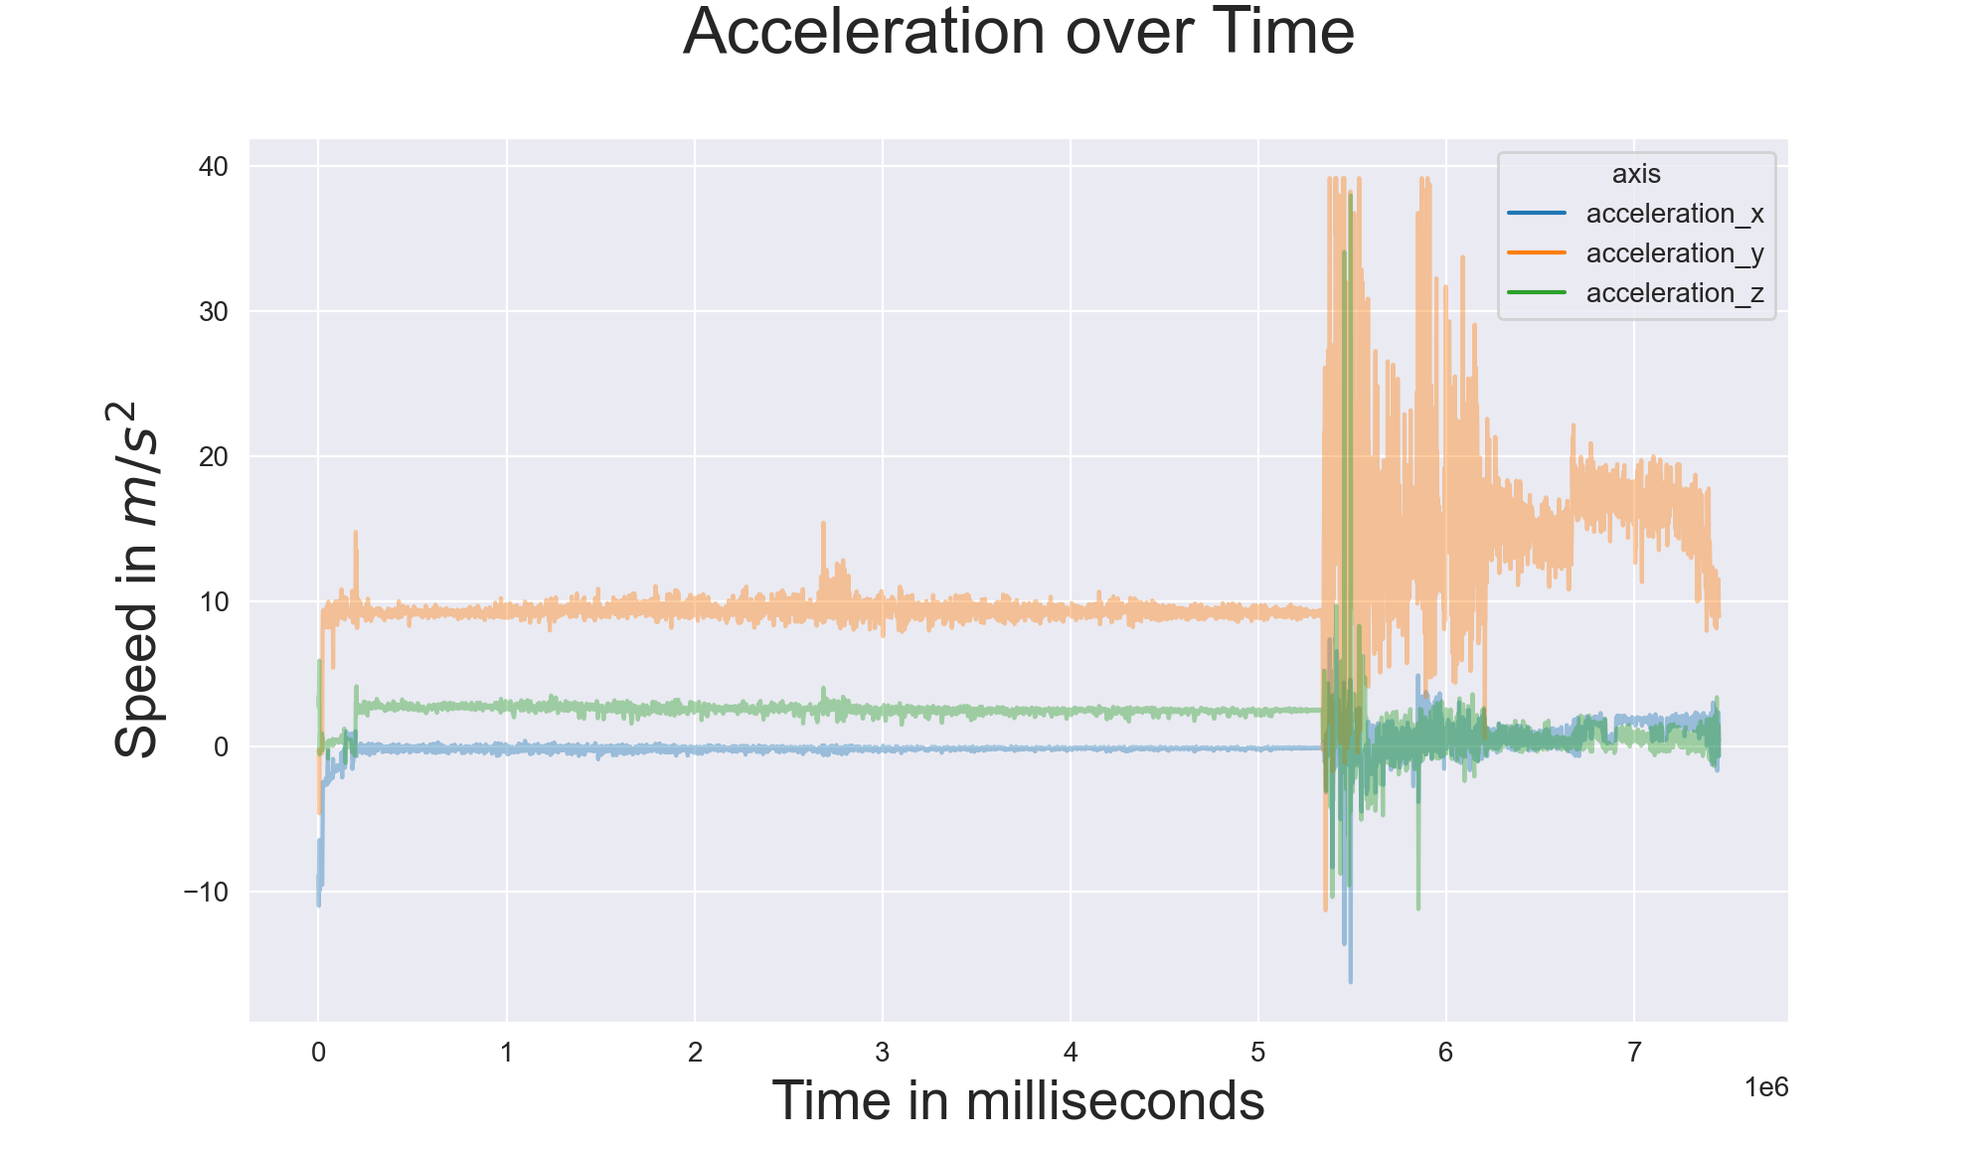
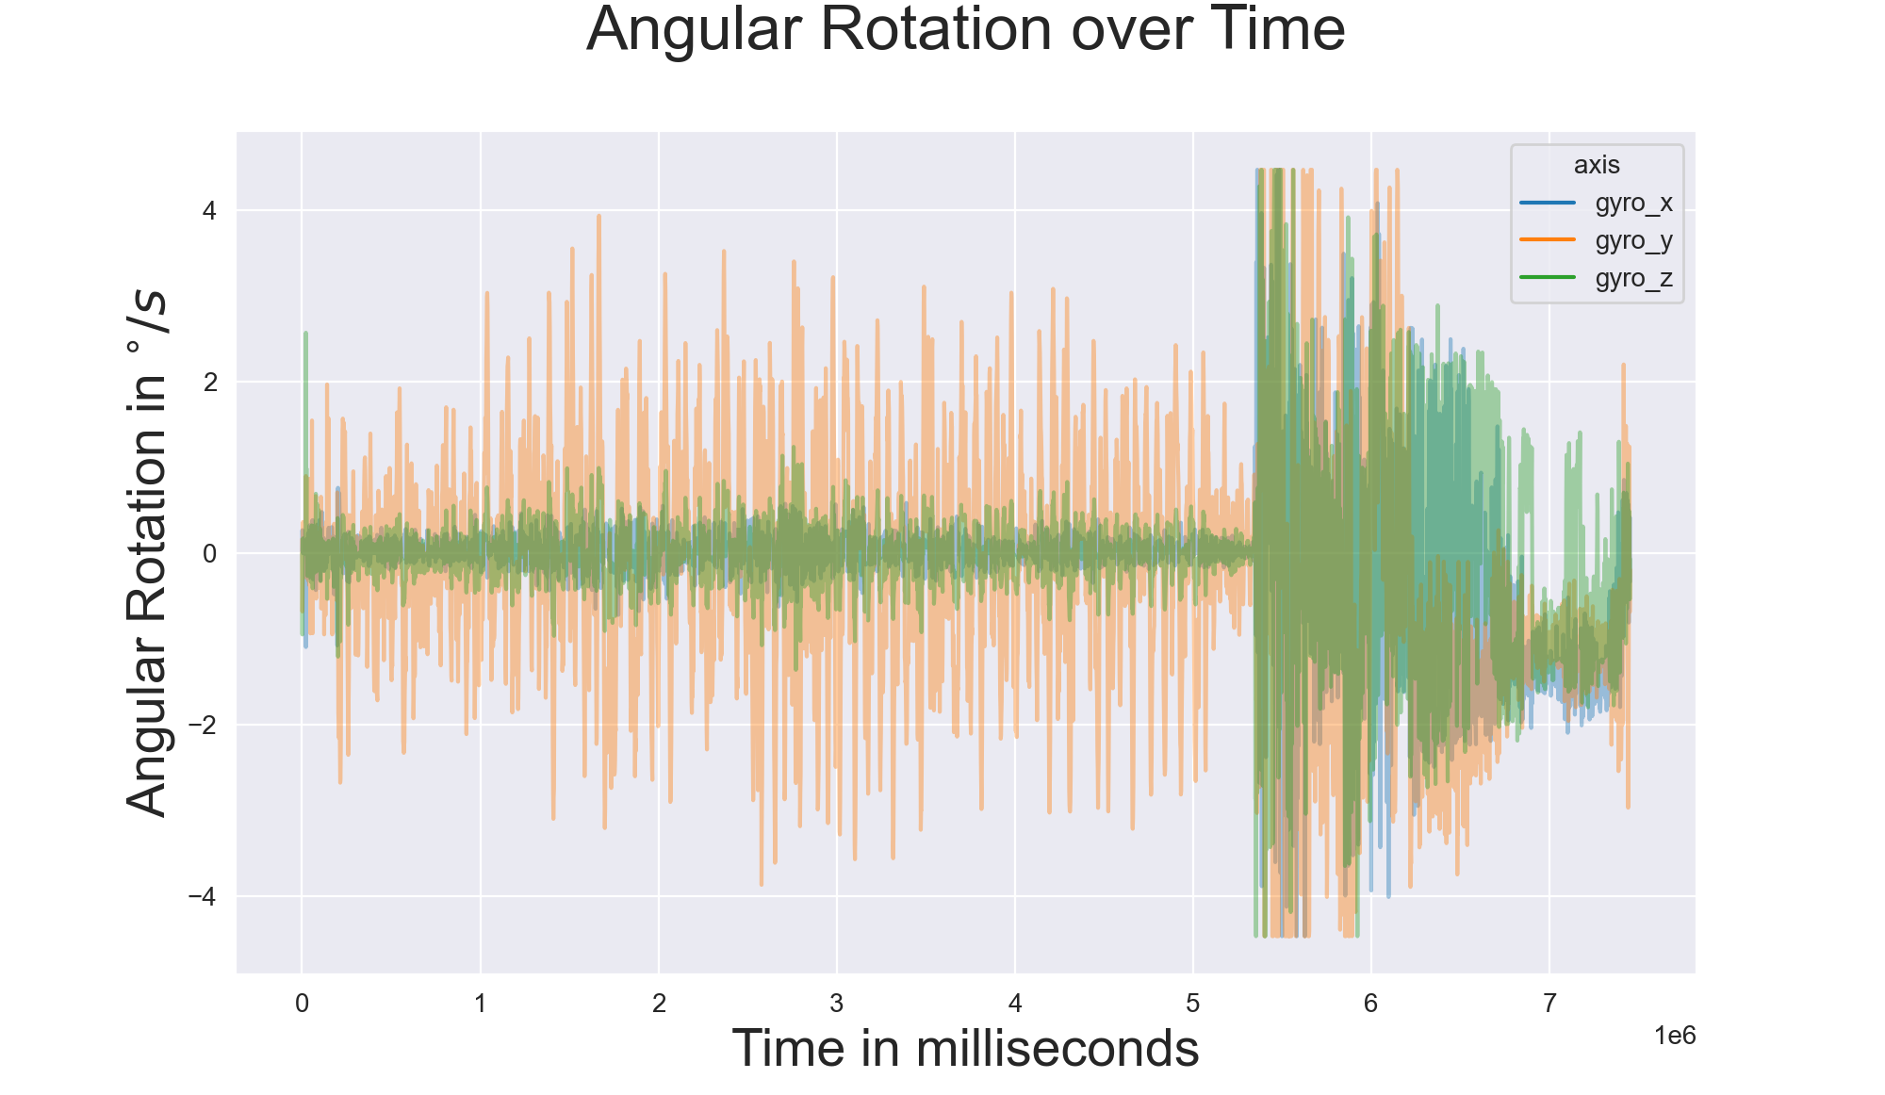
Atmospheric Profiling Results

Slide 11
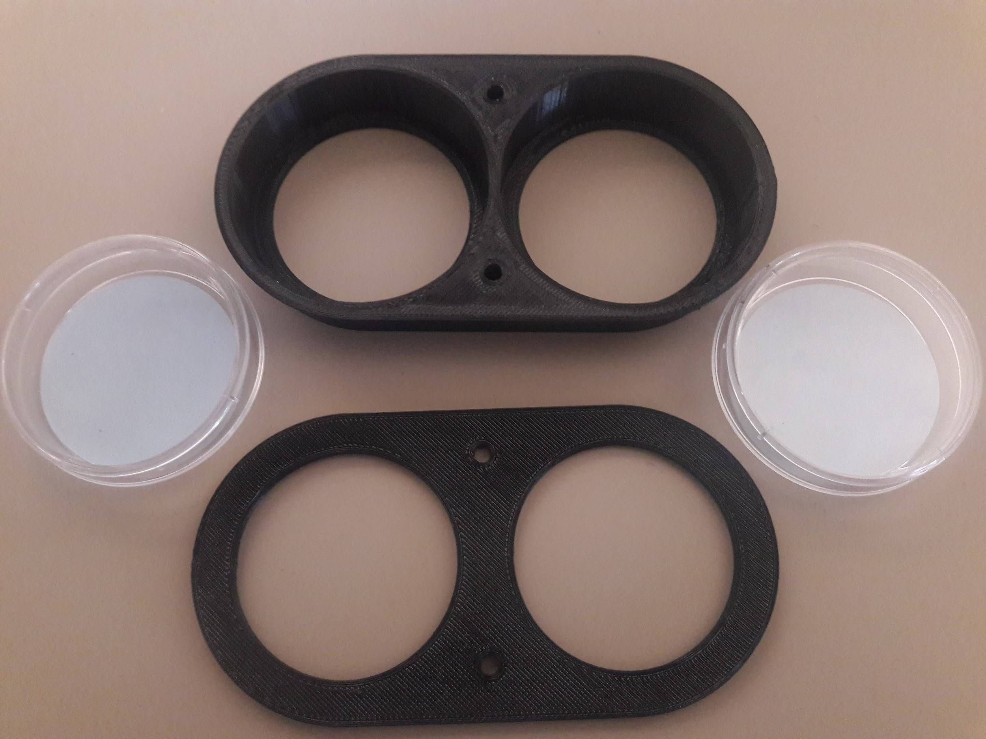
Biological Experiment
A proof of concept to design a lightweight, modular, biological experiment platform. The experiment conducted will examine the effects of UV radiation on DNA through the transportation of live and inactivated bacteria to the stratosphere. Results will be determined by observing DNA fragmentation through electrophoresis.
The experimental microbe Pseudomonas aeruginosa was chosen due to its known resilience to harsh conditions, accessibility, and safety.
Known Complications:
UV absorption of polystyrene peaks at 200 nm to 275 nm.¹
UV intensity increases with altitude.²
Range of UV that damages cells 100 nm to 320 nm.³
¹ Paul Held. “The Importance of Using the Appropriate Microplate for Absorbance Measurements in the Ultraviolet Region of the Spectrum”. In:BioTek, Technical Notes (2001),pp. 1–2.
² Blumthaler, M., Ambach, W., & Ellinger, R. (1997). Increase in solar uv radiation with altitude. Journal of Photochemistry and Photobiology B: Biology,39(2), 130–134.
³ Stanford SOLAR Center.UV Light.url:http://solar-center.stanford.edu/about/uvlight.html. (accessed: 02.26.2020).

Slide 12
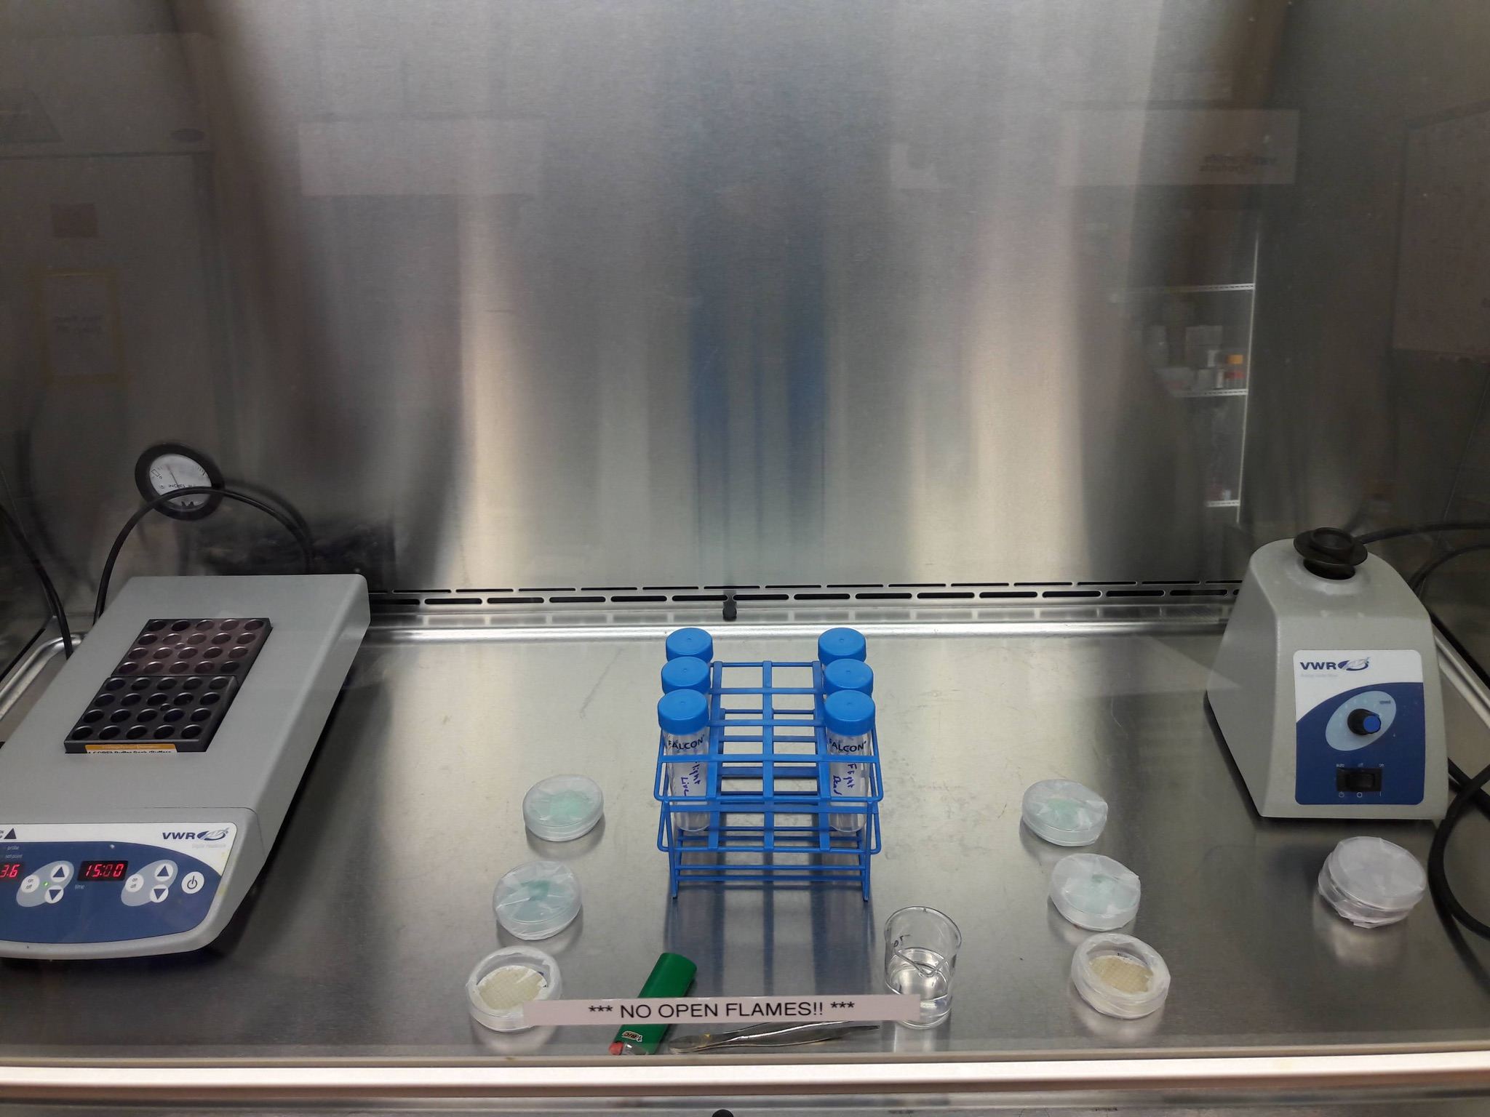
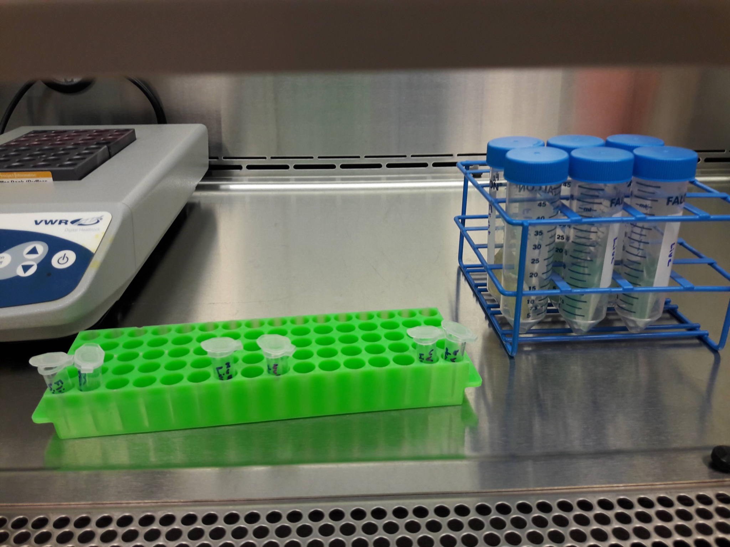
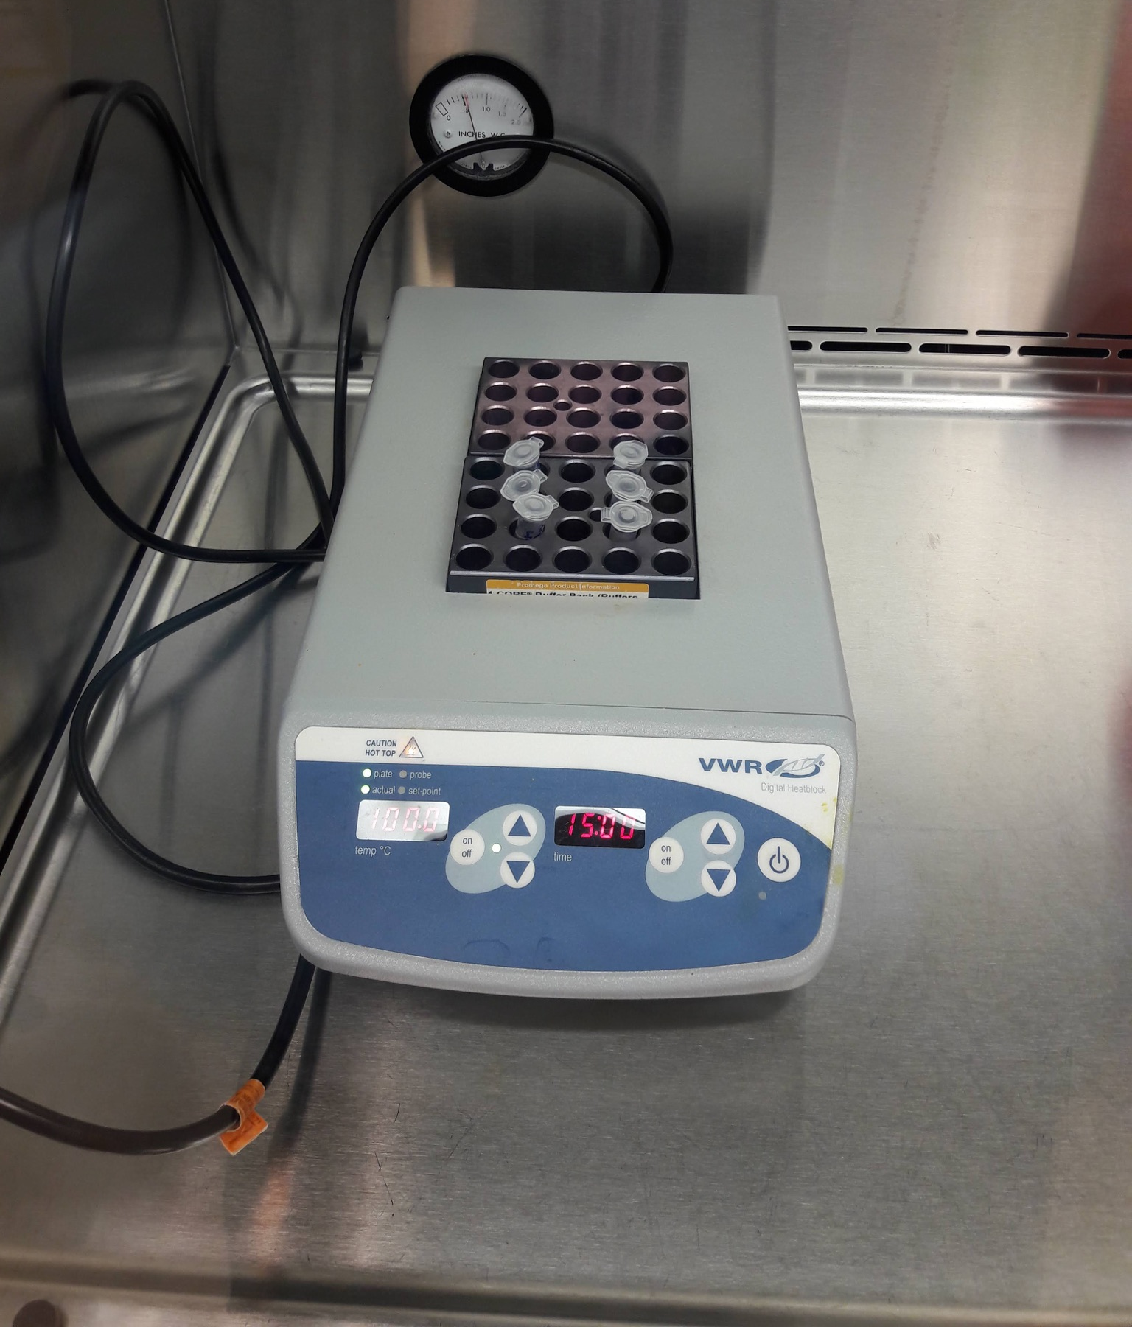
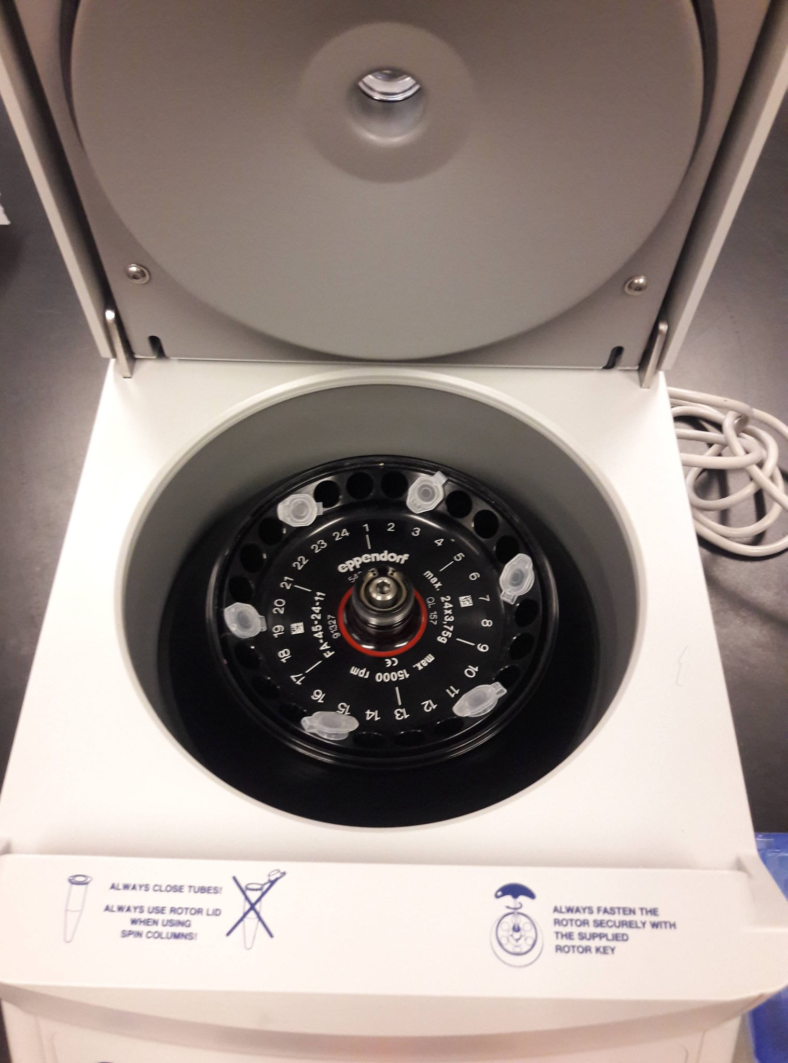
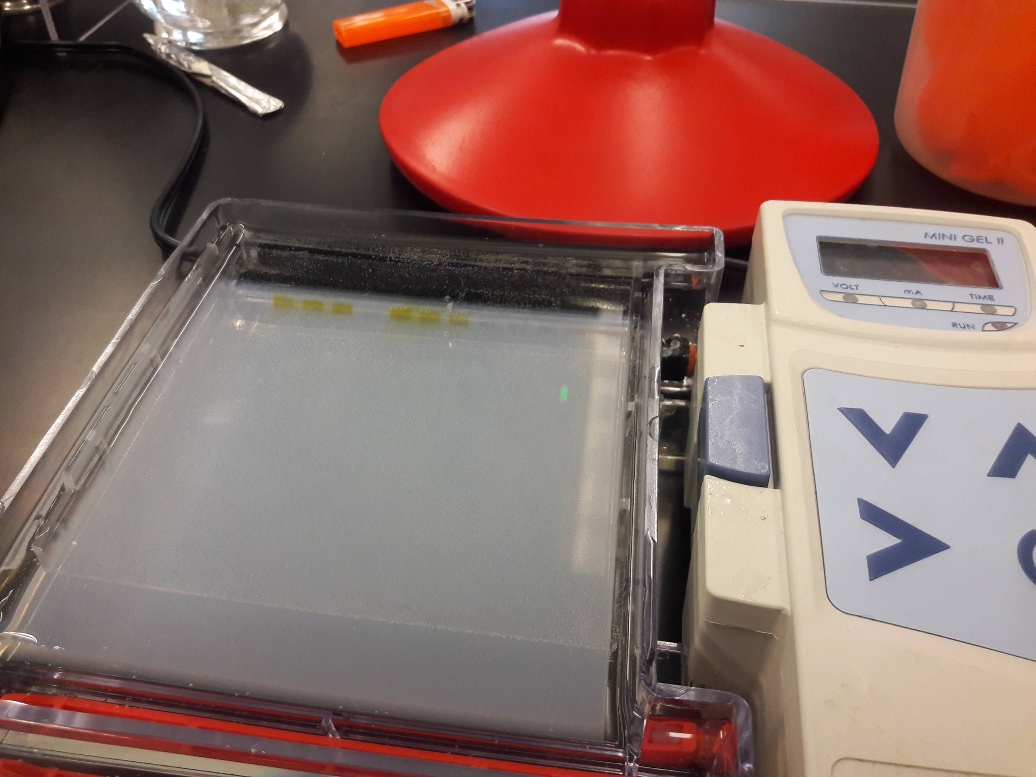
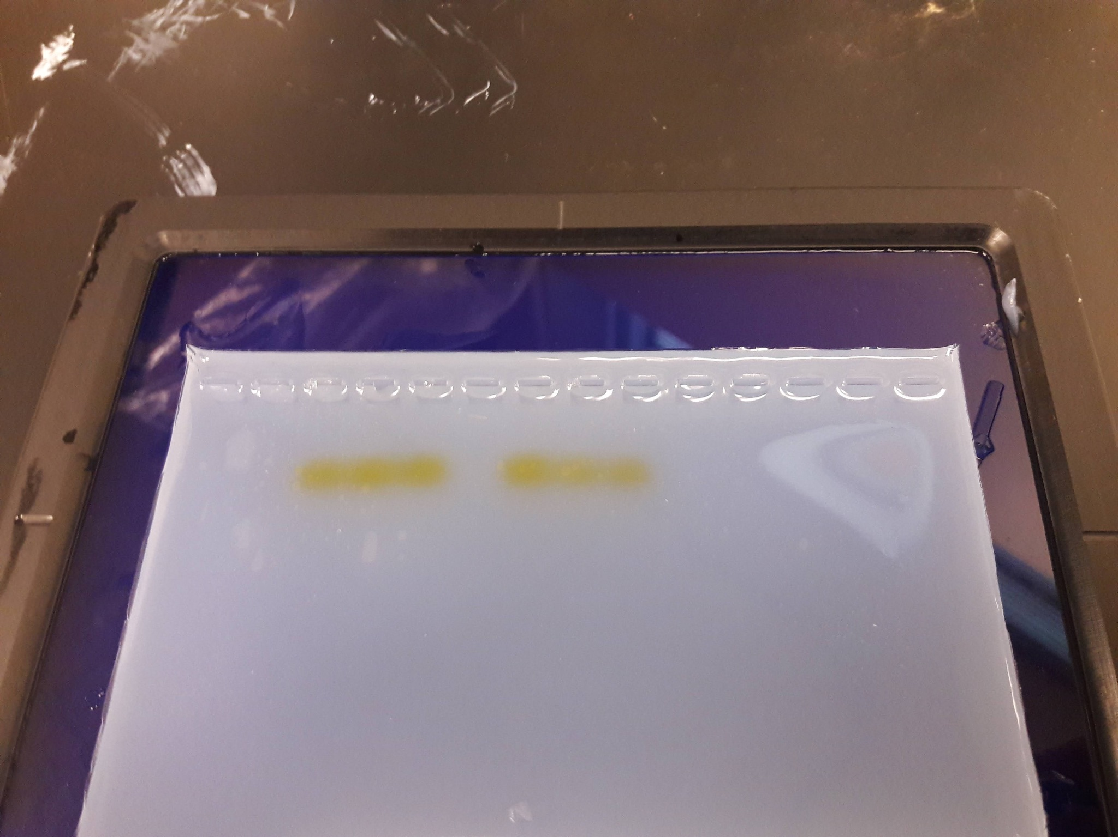
Experiment Protocol

Slide 13
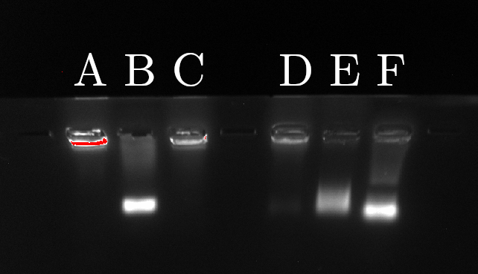
Biological Experiment
DNA Fragmentation is in order from least (1) to most (6)
Sample | Status | DNA Fragmentation
A | Live Null | 1
B | Live Flight | 4
C | Live Lab UV | 2
D | Inactivated Null | 3
E | Inactivated Flight | 5
F | Inactivated Lab UV | 6

Slide 14





Video Streaming
Python scripts process payload coordinates from the APRS web API to adjust bearing and angle of elevation of the ground station antenna
Arduino code processes these adjustments to point the antenna in the direction of the payload at all times.
The video steam is delivered via long-range WiFi from the payload to the ground station using commercial networking equipment.
Bash scripts start the streaming server and recording mechanism at boot. This allows recording and streaming to take place on the same device using one webcam.

Slide 15
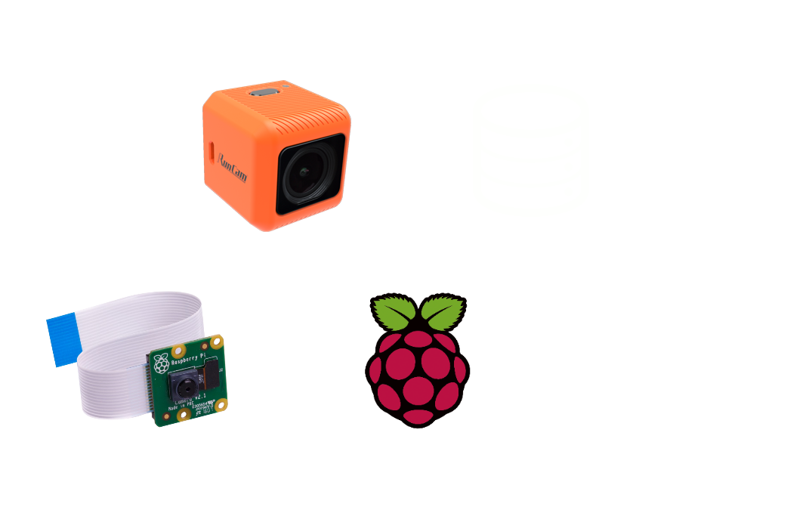
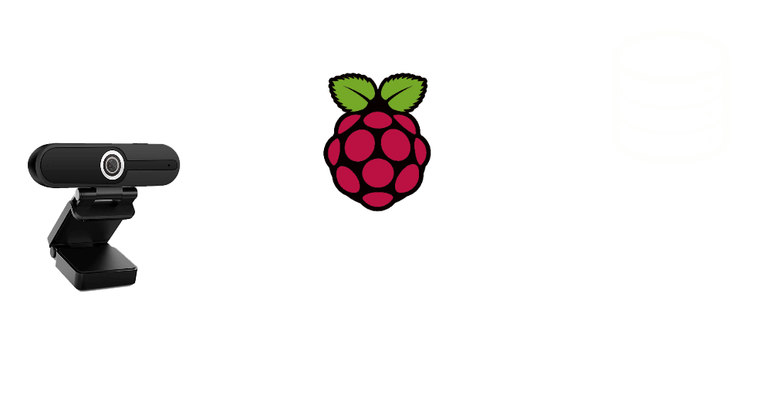
Streaming System Topology
2019/2020: Dual camera system
Stabilized, native recording
Non-stabilized, live image feed
2020/2021: Unified system
Single camera, stabilized system with native recording and live video feed
Raspi creates server, FFMPEG records stream output from URL (loopback)

Slide 16
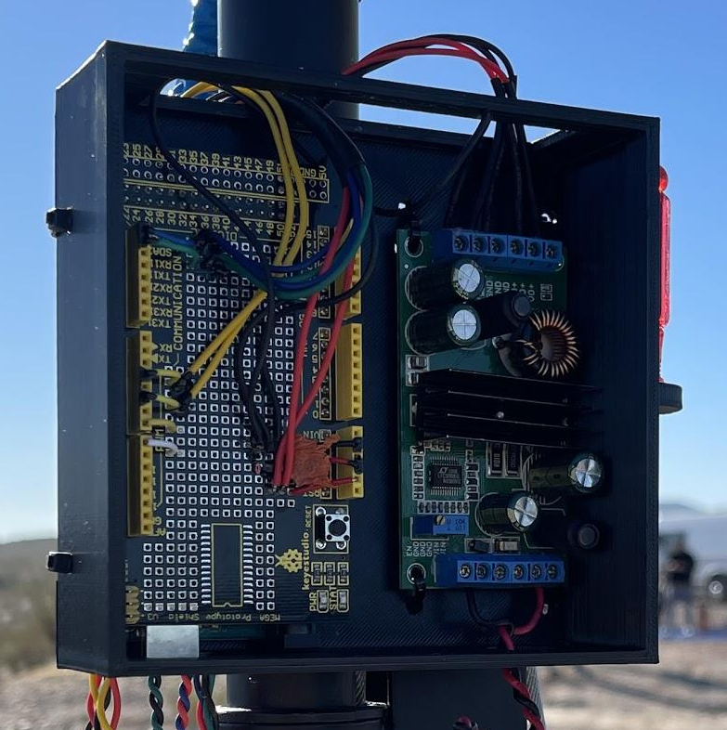
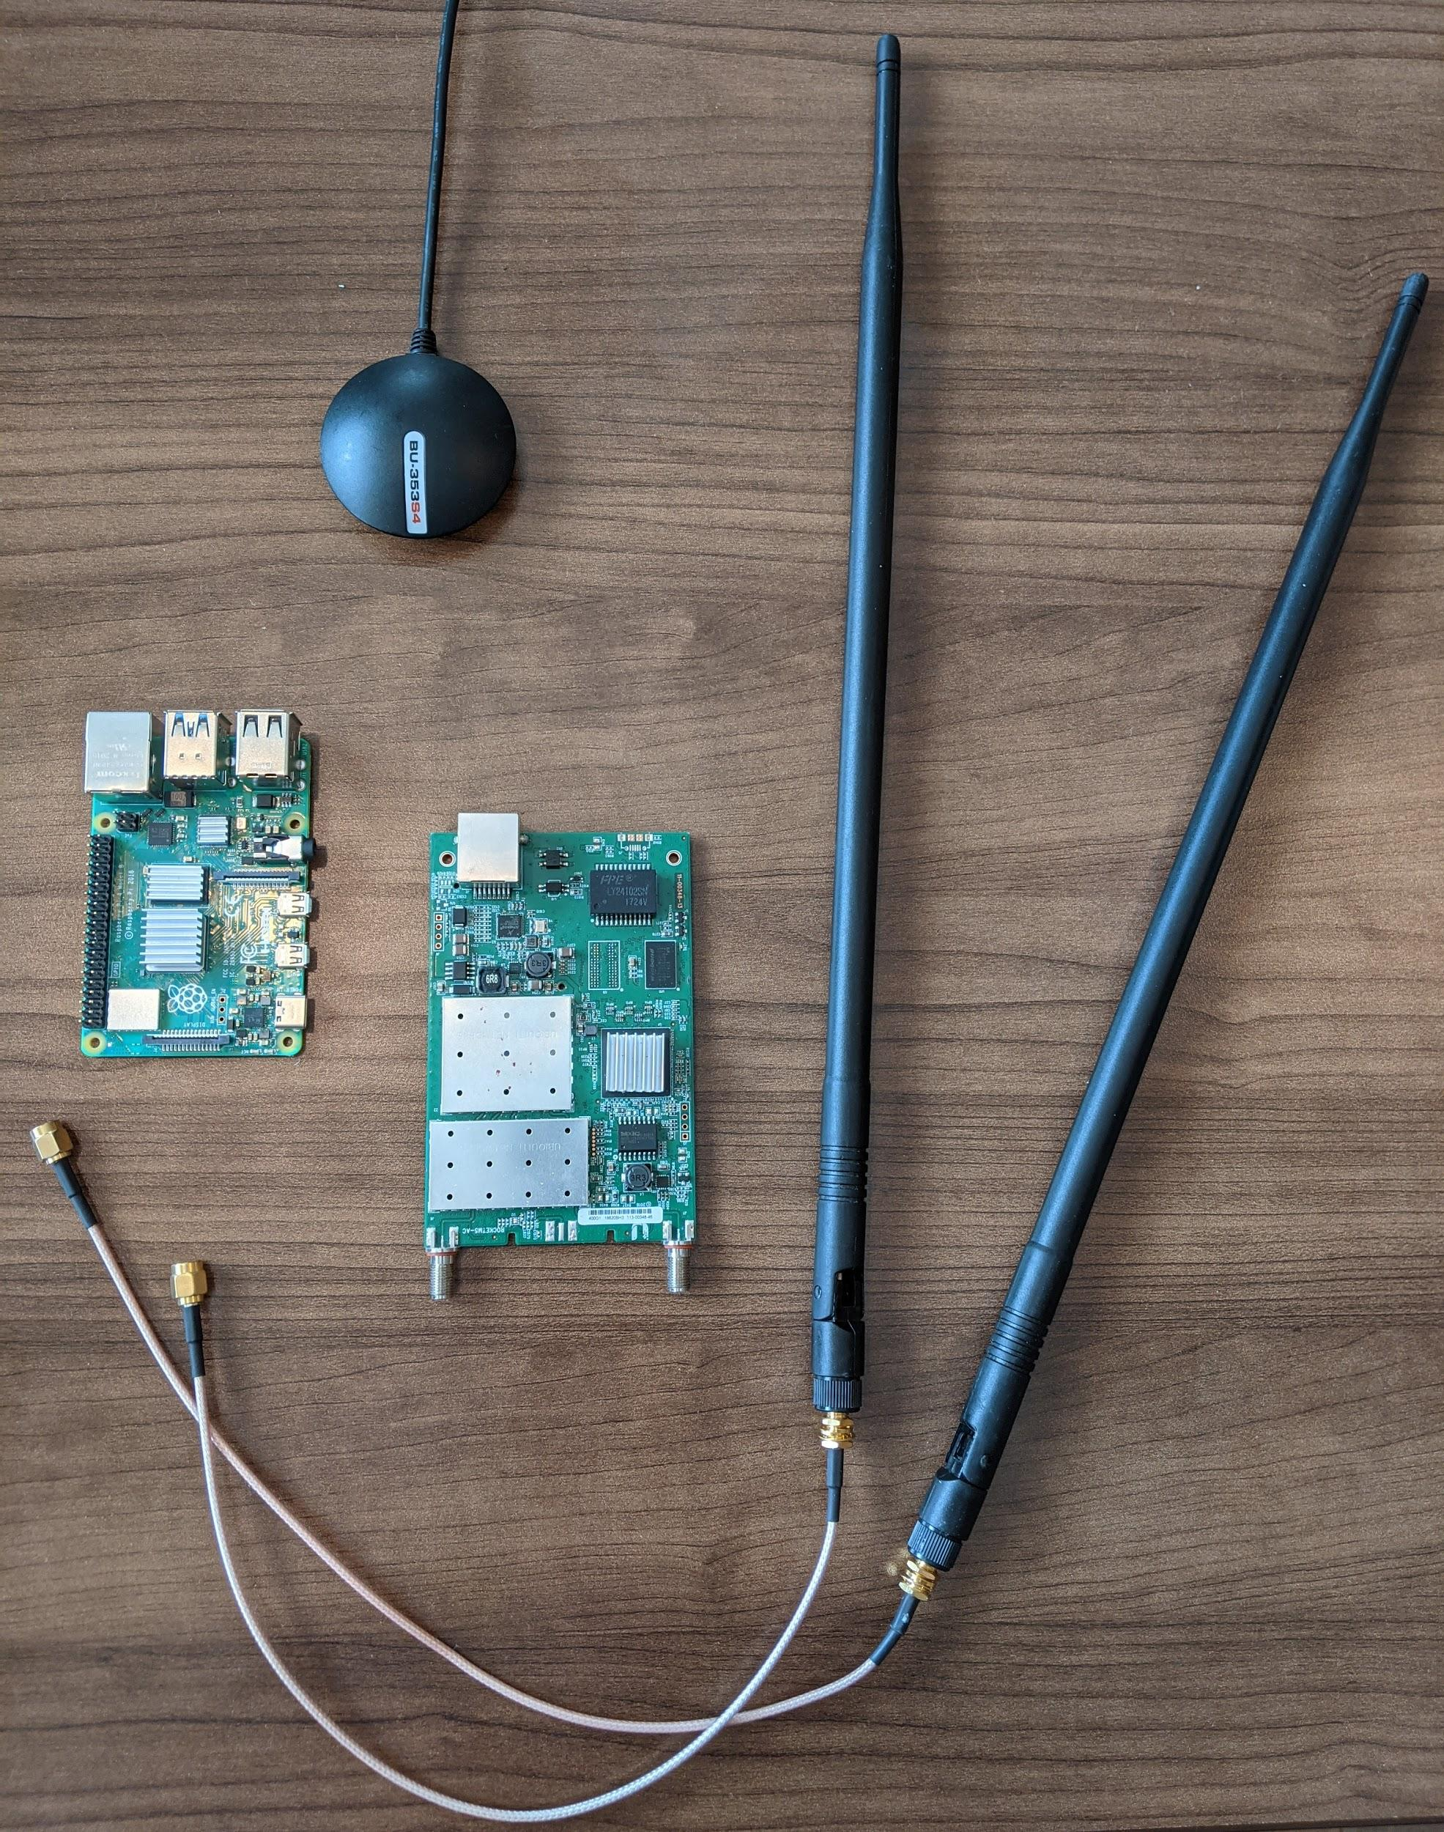
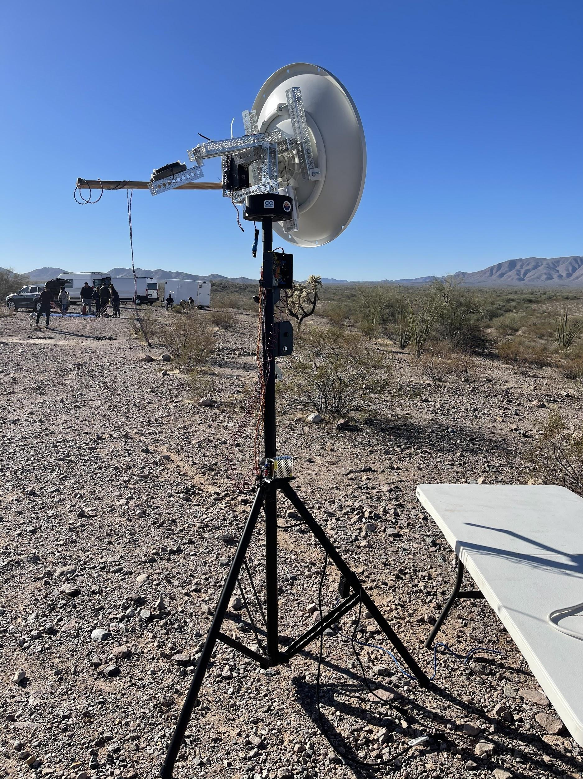
Video Streaming
Components
The components that are used for streaming is a Raspberry Pi to handle the video that was extracted from a camera recording in 2560x1440. This camera is stabilized which had to use a slip ring in order for the cable to spin and to not interrupt video or power. The system is then connected to a ubiquiti router through PoE which then talks to the antenna that’s on the ground.
The antenna uses an arduino mega that’s connected to a GPS unit and a magnetometer to determine where the antenna is point in respect to the payload. The way the antenna talks to the payload is by using the same ubiquiti router in a PTP system.

Slide 17
Video streaming - improvements for components
With the components that were used, when the payload officially launched the antenna could not point 90 degrees. Since this issue was present; for a good portion of the flight the ubiquiti system could not connect. For the next year the focus of video streaming will be on improving the rotation of the antenna. Another issue the antenna had was the APRS tracking taking close to a minute to update. Due to this the teams goal is to get a ham license for more accurate updates on where the payload is. During flight the antenna was powered through car battery thanks to an inverter. However with the car battery, from observation, whenever the car would turn on the antenna would snap to the wrong direction. To solve this issue a battery will be made to work and power the whole ground system. Even though the video wasn’t streamed, the video that was recorded still made it.

Slide 18
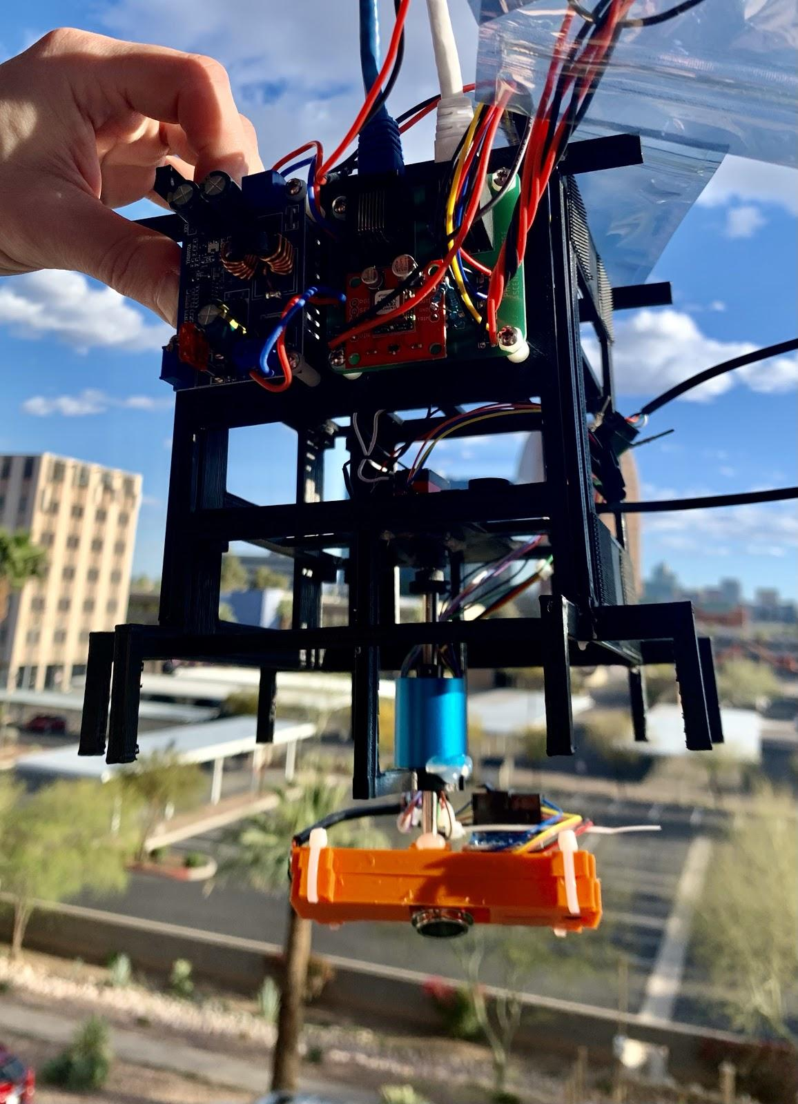
Video Stabilization
Provides clear, precise and steady video footage.
Reduces shakiness and disorientation to the viewer.
A sensor, and servo are powered through an Arduino Nano
The system was integrated into the interior design of the payload.

Slide 19
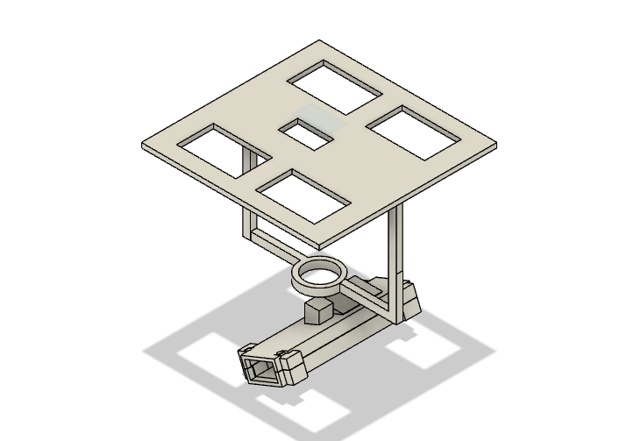

Mechanical & Programming Aspects
Mount that holds Arduino Nano and Servo.
Four holes to make it lighter.
In the Arduino program, it gets yaw from the mpu6050
Depending on the position with respect to yaw, a percentage is calculated to establish the direction and speed of a servo which must rotate towards yaw =0.
Support for Slip Ring.
MPU6050
Camera Case.

Slide 20
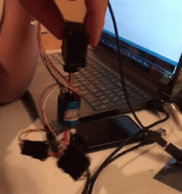
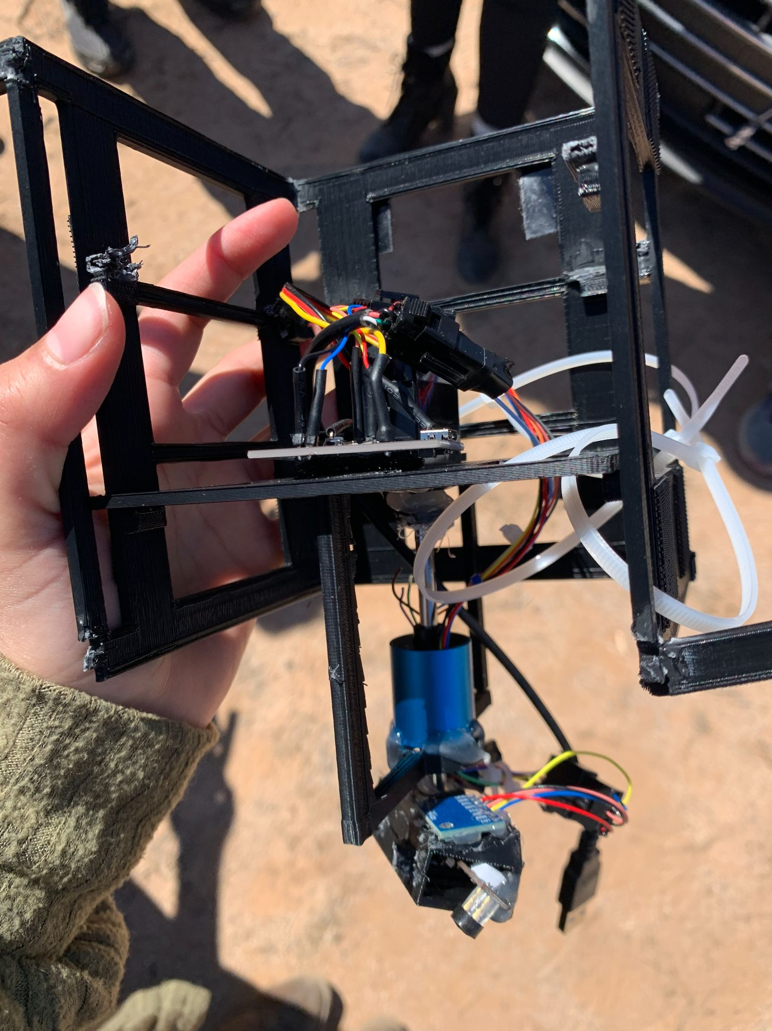
What Went Well
What Could Have Been Improved
The mount design endured the entire flight with minor damages upon landing ensuring recorded footage of the entire flight
The system working smoothly prior to the launch is shown here
Further testing with a plastic gear servo instead of a metal gear servo that we had originally planned on using. A plastic gear had snapped when modifying for continuous rotation.
Therefore, for the launch we had a static camera system.
We instead hot glued the slip ring to the mount

Slide 21
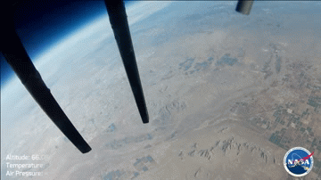
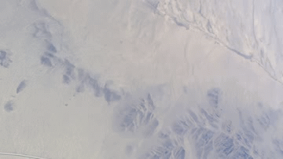
The Importance of an Active Camera Stabilization System
With Stabilization
Phoenix College ASCEND 2019W
Without Stabilization
Phoenix College ASCEND 2021

Slide 22
Thank You
Arizona Near Space Research
Arizona Space Grant Consortium
University of Arizona
Printed Circuit Boards
Advanced Circuits
Michelle Coe
Ernest Villicaña
Dr. Eddie Ong
Biological Experiment
Daisy Rodriguez
Matt Haberkorn
Dr. Robin Cotter

